Slide 1
GPT NLP Lab Assistant Group 3
The Autonomous University Robot Assistant (AURA) Project - Artificial Intelligence Subsystem
Michael Fritzer

Slide 2
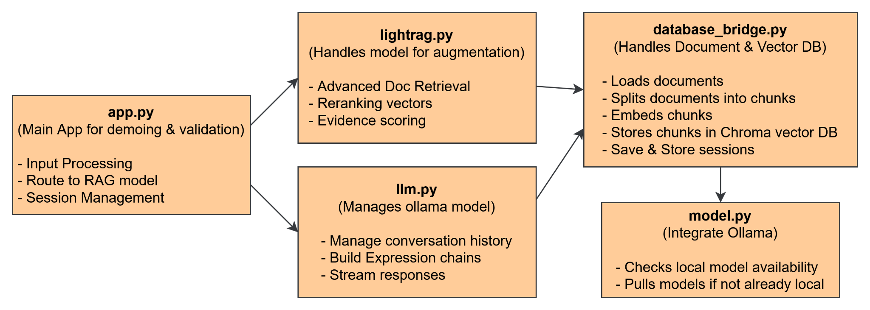
Schematics

Slide 3
Functions
Main accomplishment was creating a suite of functions & a custom RAG class to be used next semester for robot development.
LightRAG class built from a recent ArVix Paper

Slide 4
Document Vectorization & Model Loading

Slide 5
System in action w/ RAG

Slide 6
Validation

